Slide 1
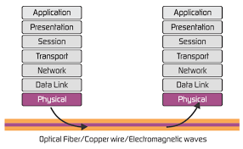
Unit 1: Physical Layer

Slide 2
Taxonomy
Computer Network Taxonomy: Transmission technology and Scale
Transmission technology: broadcast links & point-to-point links
Point-to-point links connect individual pairs of m/c.
Often multiple routes, of different lengths, are possible, so finding good ones is important in p-t-p networks.
P-t-p transmission with exactly one sender and exactly one receiver is called as unicasting.
In contrast, on a broadcast network, the commn ch is shared by all the m/c on the n/w; pkts sent by any m/c are received by all the others.
Address field.

Slide 3
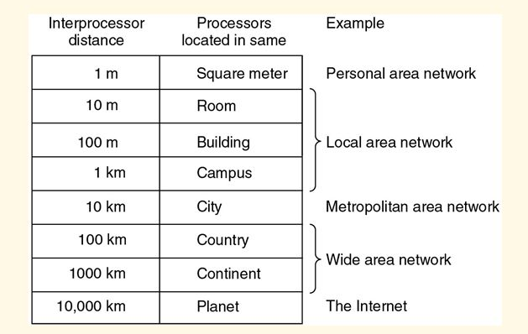
A wireless network is a common example of a broadcast link.
Some broadcast systems also support transmission to a subset of m/c, which is known as multicasting.
Scale: Distance is important as a classification metric bcoz different technologies are used as different scales.

Slide 4
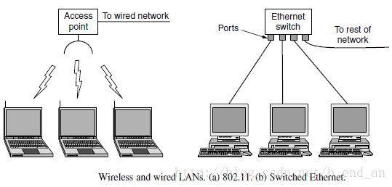
TYPES OF NETWORK
PAN (Personal Area Network) : ex: Bluetooth, RFID
LAN (Local Area Network): ex: bldg, home, office etc.
Access point, wireless router or base station.
Wireless LAN (IEEE 802.11 known as WiFi) speed 11-100Mbps
The topology of many wired LANs is build from p-t-p links (Ethernet IEEE 802.3)

Slide 5
MAN (Metropolitan Area Network): covers city; ex: Cable
WiMAX (IEEE 802.16) High speed wireless internet access.
WAN (Wide Area Network): Country/continent;
A WAN is a geographically-dispersed collection of LANs. A network device called a router connects LANs to a WAN.

Slide 6
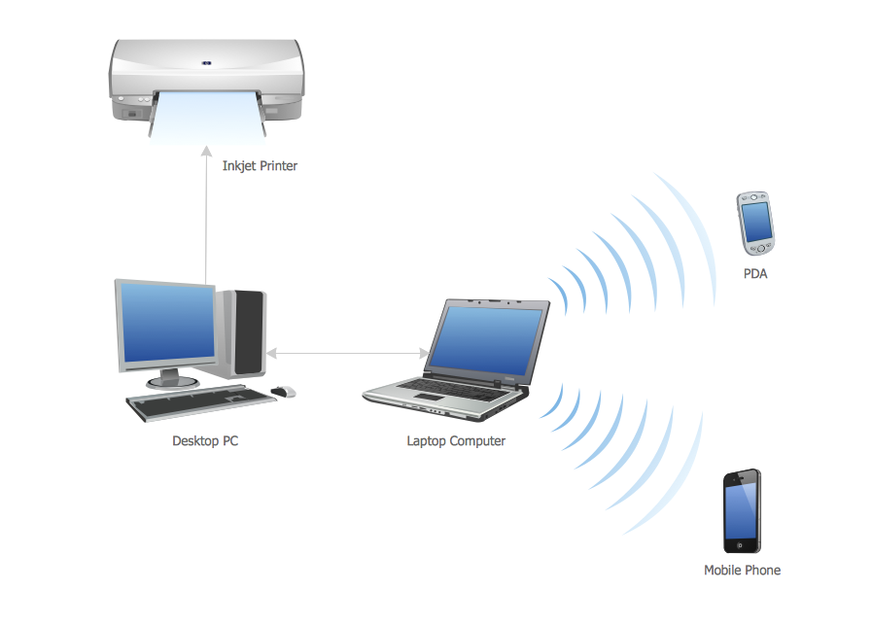
PAN

Slide 7
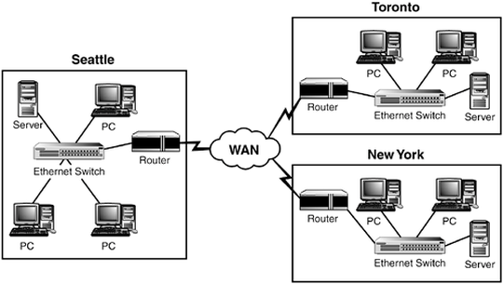
WAN

Slide 8
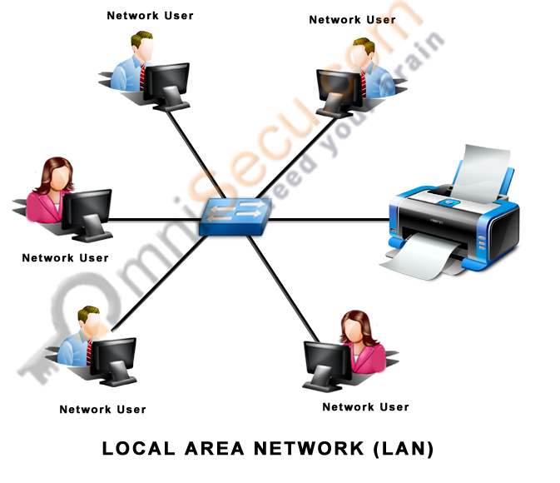

Slide 9
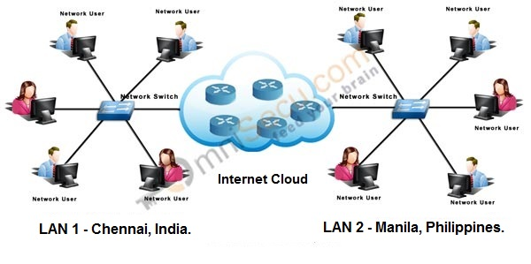
WAN

Slide 10
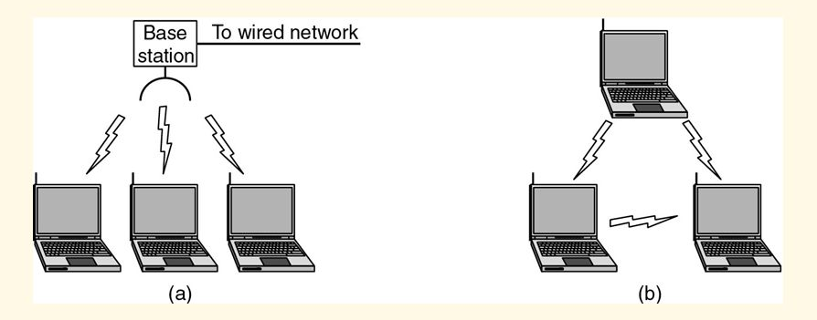
Infrastructure and Ad-Hoc Mode
Notes:
Wi-Fi Direct standard also builds on ad-hoc mode

Slide 11
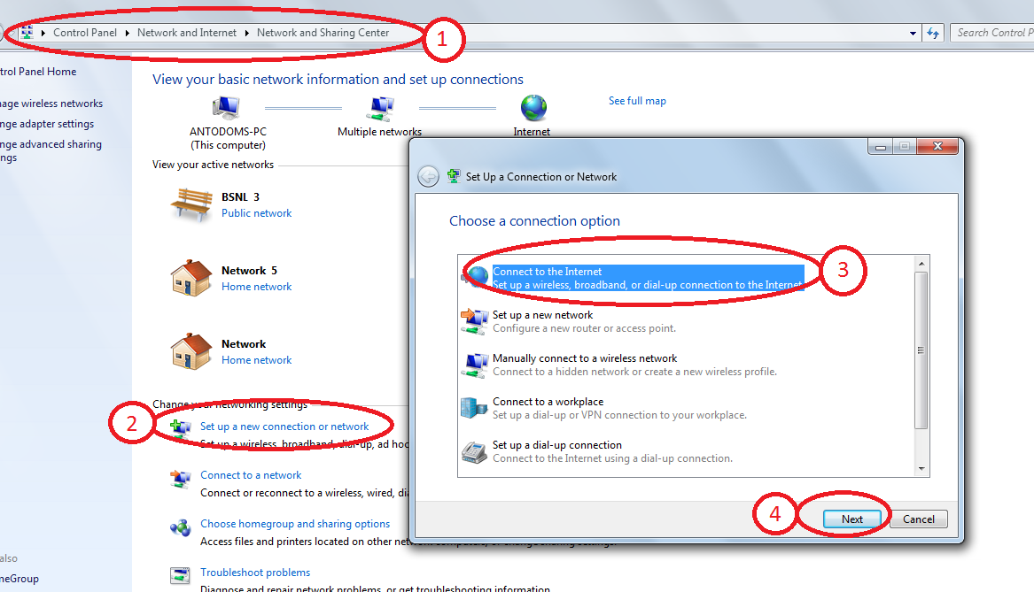

Slide 12
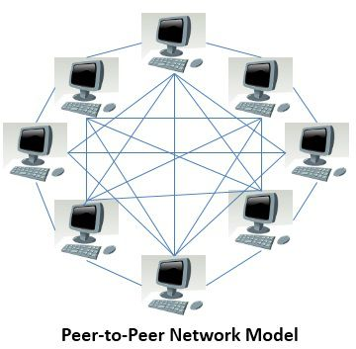
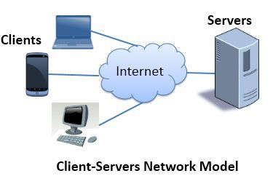
Network Architectures
The Client-Server network model focuses on information sharing whereas, the Peer-to-Peer network model focuses on connectivity to the remote computers.
The main difference between the Client-Server and Peer-to-Peer network model is that in Client-Server model, the data management is centralised whereas, in Peer-to-Peer each user has its own data and applications

Slide 13
Client-Server
The Client-Server network model is widely used network model. Here, Server is a powerful system that stores the data or information in it. On the other hands, the Client is the machine which let the users access the data on the remote server.
The system administrator manages the data on the server. The client machines and the server are connected through a network. It allows the clients to access data even if the client machine and server are far apart from each other.
In Client-Server model, the client process on the client machine sends the request to the server process on the server machine. When the server receives the client request, it lookouts for the requested data and send it back with the reply.
As all the services are provided by a centralized server, there may be chances of server getting bottlenecked, slowing down the efficiency of the system.

Slide 14
Peer-to-Peer
Unlike Client-Server, the Peer-to-Peer model does not distinguish between client and server instead each node can either be a client or a server depending on the whether the node is requesting or providing the services. Each node is considered as a peer.
To become a part of peer-to-peer, a node must initially join the network. After joining it must start to provide services to and must request the services from other nodes in the peer-to-peer system. There are two ways to know which node provides which services; they are as follow:
When a node enters the peer-to-peer system, it must register the services it will be providing, into a centralized lookup service on the network. When a node desires for any specific service it must contact centralized lookup services to check out which node will provide the desired services. Rest of the communication is done by the desiring node and the service providing node.
A node desiring for the specific services must broadcast the request for services to all other nodes in the peer-to-peer system. The node providing the requested service will respond to the node making the request.
Peer-to-Peer network has the advantage over client-server that the server is not bottlenecked as the services are provided by the several nodes distributed in a peer-to-peer system.

Slide 15
BASIS FOR COMAPAISON | CLIENT-SERVER | PEER-TO-PEER
Basic | There is a specific server and specific clients connected to the server. | Clients and server are not distinguished; each node act as client and server.
Service | The client request for service and server respond with the service. | Each node can request for services and can also provide the services.
Focus | Sharing the information. | Connectivity.
Data | The data is stored in a centralized server. | Each peer has its own data.
Server | When several clients request for the services simultaneously, a server can get bottlenecked. | As the services are provided by several servers distributed in the peer-to-peer system, a server in not bottlenecked.
Expense | The client-server are expensive to implement. | Peer-to-peer are less expensive to implement.
Stability | Client-Server is more stable and scalable. | Peer-to-Peer suffers if the number of peers increases in the system.

Slide 16
Standardized Protocol
Vendors like standards because they make their products more marketable
Customers like standards because they enable products from different vendors to interoperate
Two protocol standards are well-known:
TCP/IP: widely implemented
OSI: less used, still useful for modeling / conceptualizing

Slide 17
The OSI Reference Model
Principles for the seven layers
Layers created for different abstractions
Each layer performs well-defined function
Function of layer chosen with definition of international standard protocols in mind
Minimize information flow across interfaces between boundaries
Number of layers optimum
ISO is the organization;
OSI is the model.

Slide 18
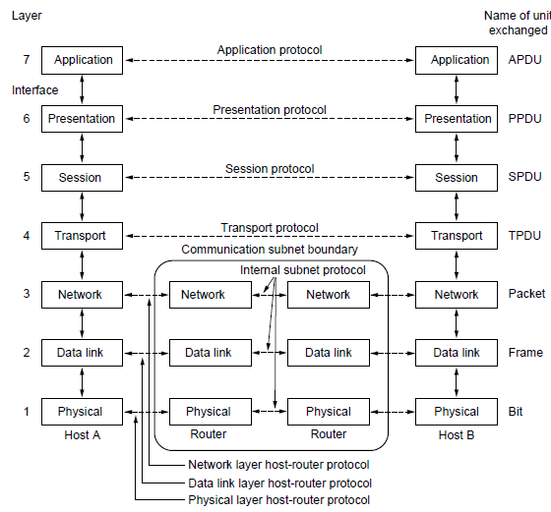

Slide 19
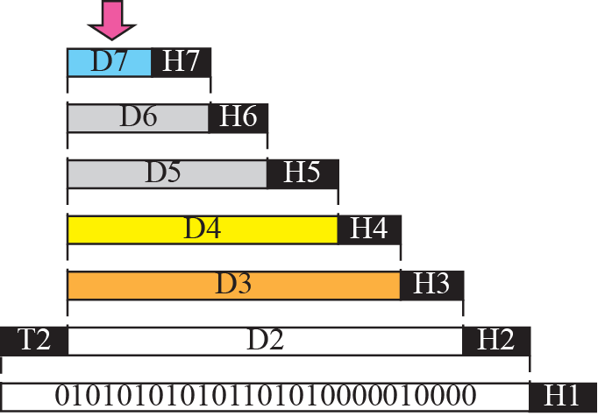



Slide 20
Physical Layer
Bit (0 or 1)
Bi-direction
Connection (estb, tear down)
Connectors
Voltage
Pin assignments
e.g. RS-232

Slide 21
Data Link Layer
Access to media
Provides reliable transfer of data across media.
Flow control.
Framing
Addressing
Error control
e.g. HDLC

Slide 22
Network Layer
Controlling Subnet
Routing
Addresses Resolution
Congestion Control Mgt.
Determines Quality of Service
Concerned with type of switching used
Example: X.25 standard for network access procedures on packet-switching networks

Slide 23
Transport Layer
End-to-end connection reliability
Establishes, maintains, and terminates virtual circuits. / multiple network connections
Error Control
Flow Control
Congestion Control
Fragmentation and reassembly

Slide 24
Session Layer
Establishes, manages and terminates sessions between applications
Manages log-ons, password exchange, log-offs
Sessions offer various services, including dialog control, token management and synchronization.

Slide 25
Presentation Layer
Data representation
Format of data
Ensure data is readable by receiving system
Negotiates data transfer syntax for application layer
Examples
File conversion from ASCII to EBDIC

Slide 26
Application Layer
Provides network services to application processes ( E- mail, file transfer, terminal emulation )

Slide 27
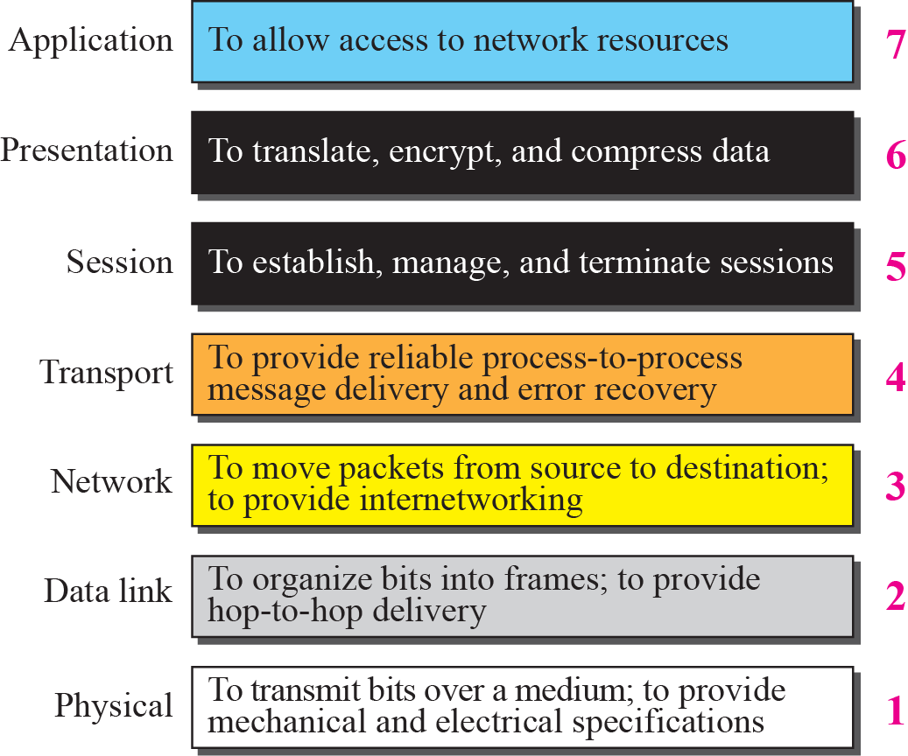
Summary of OSI Layers

Slide 28
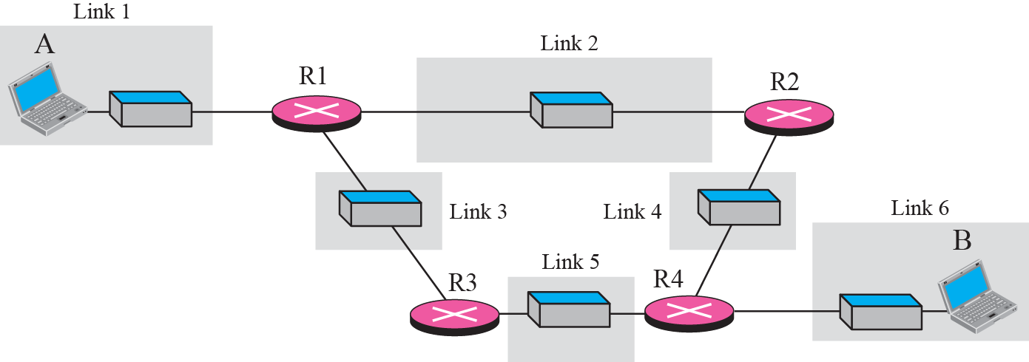
A private internet

Slide 29
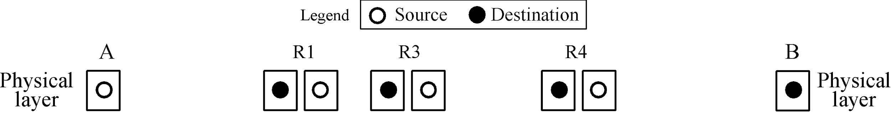








Communication at the physical layer

Slide 30

Note
The unit of communication at the physical layer is a bit.

Slide 31
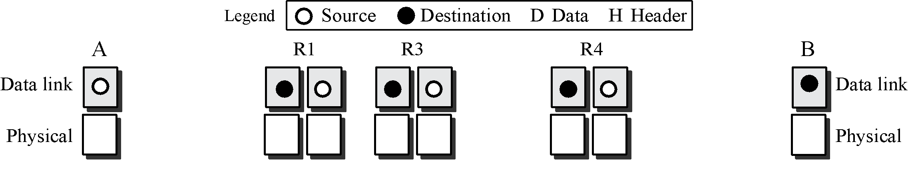
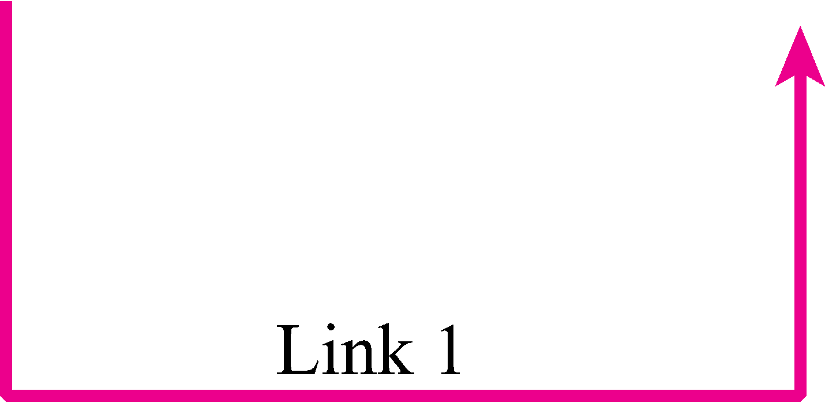

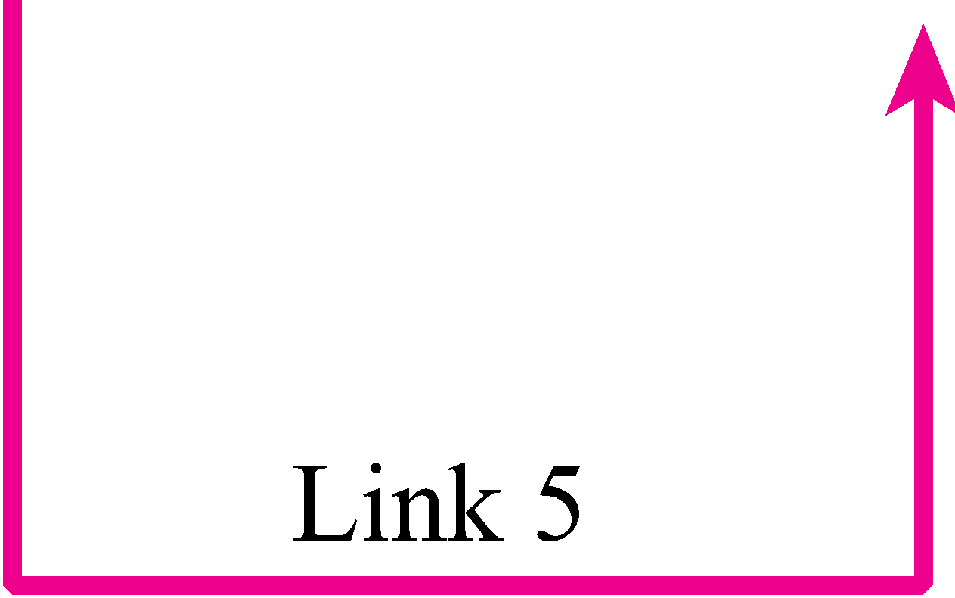

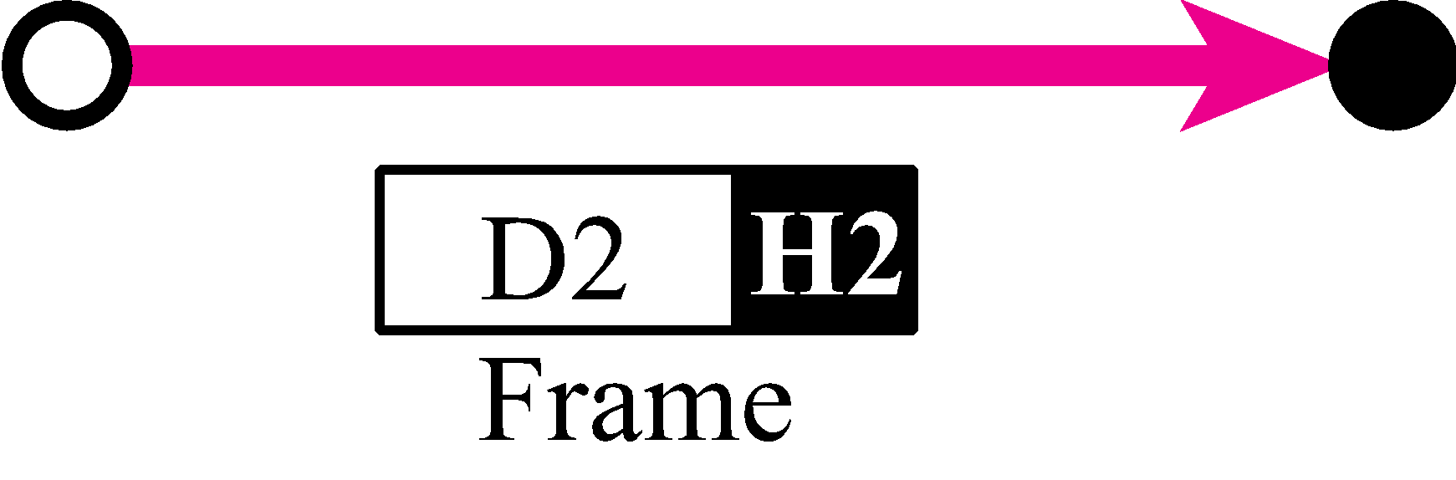
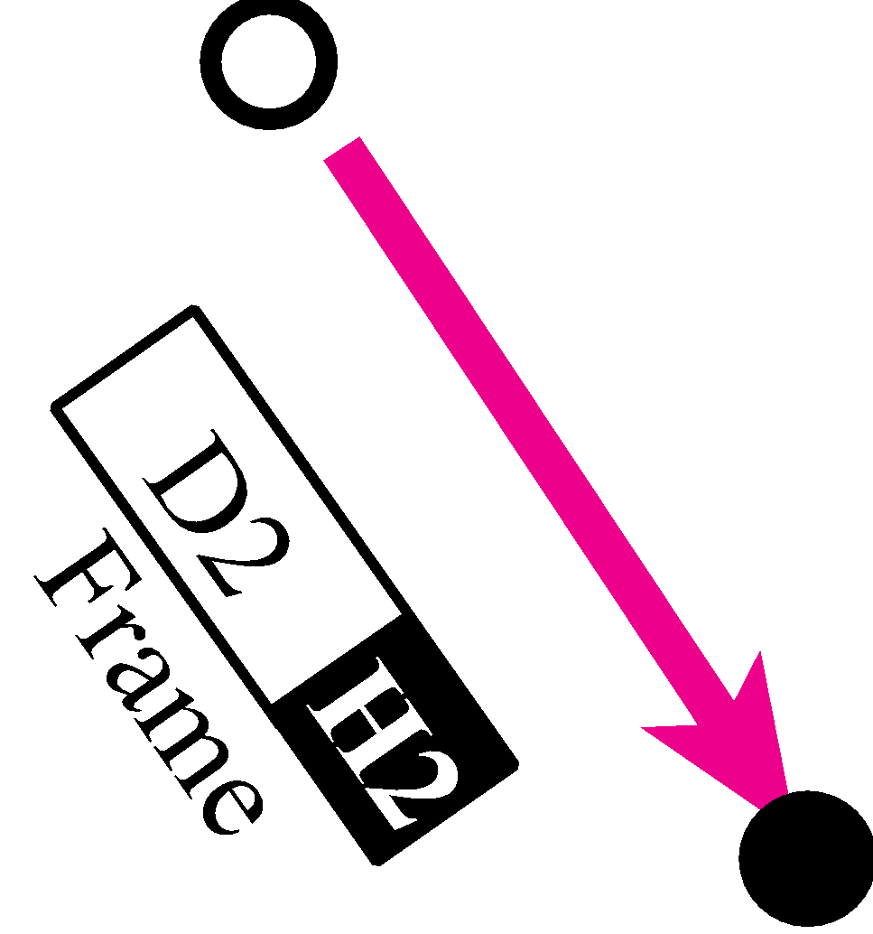
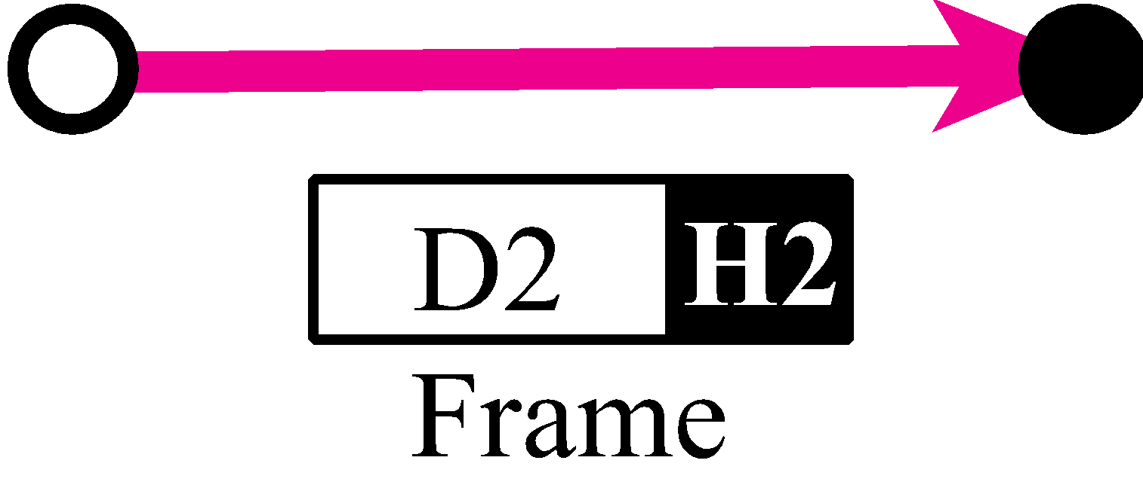
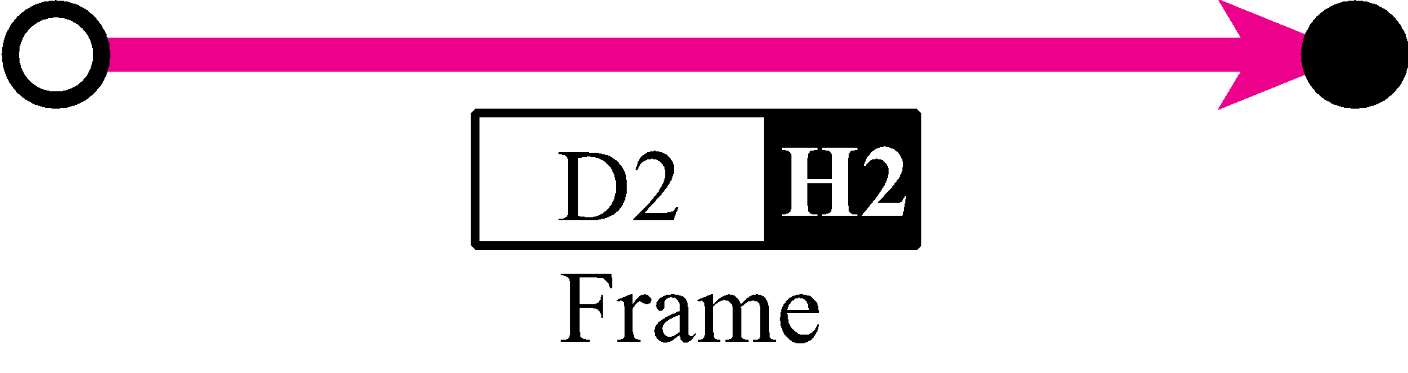
Communication at the data link layer

Slide 32
Note
The unit of communication at the data link layer is a frame.

Slide 33
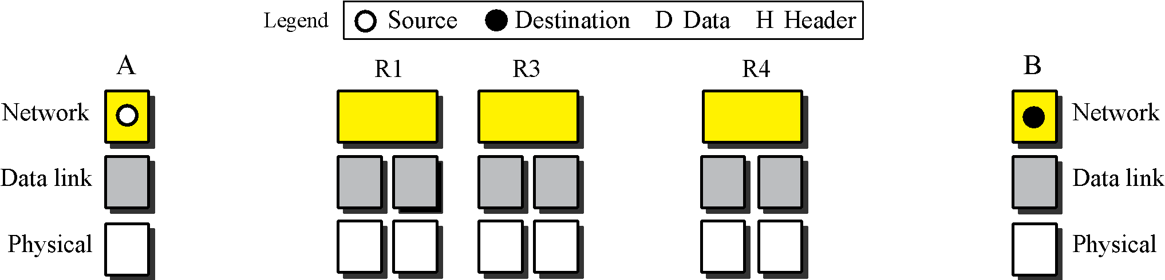

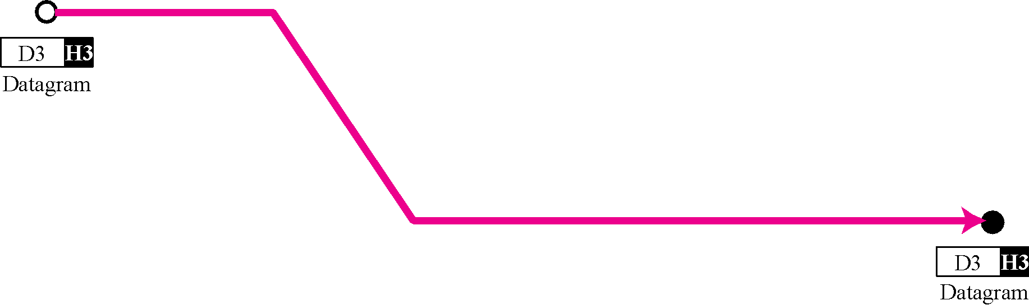
Communication at the network layer

Slide 34
Note
The unit of communication at the network layer is a datagram.

Slide 35
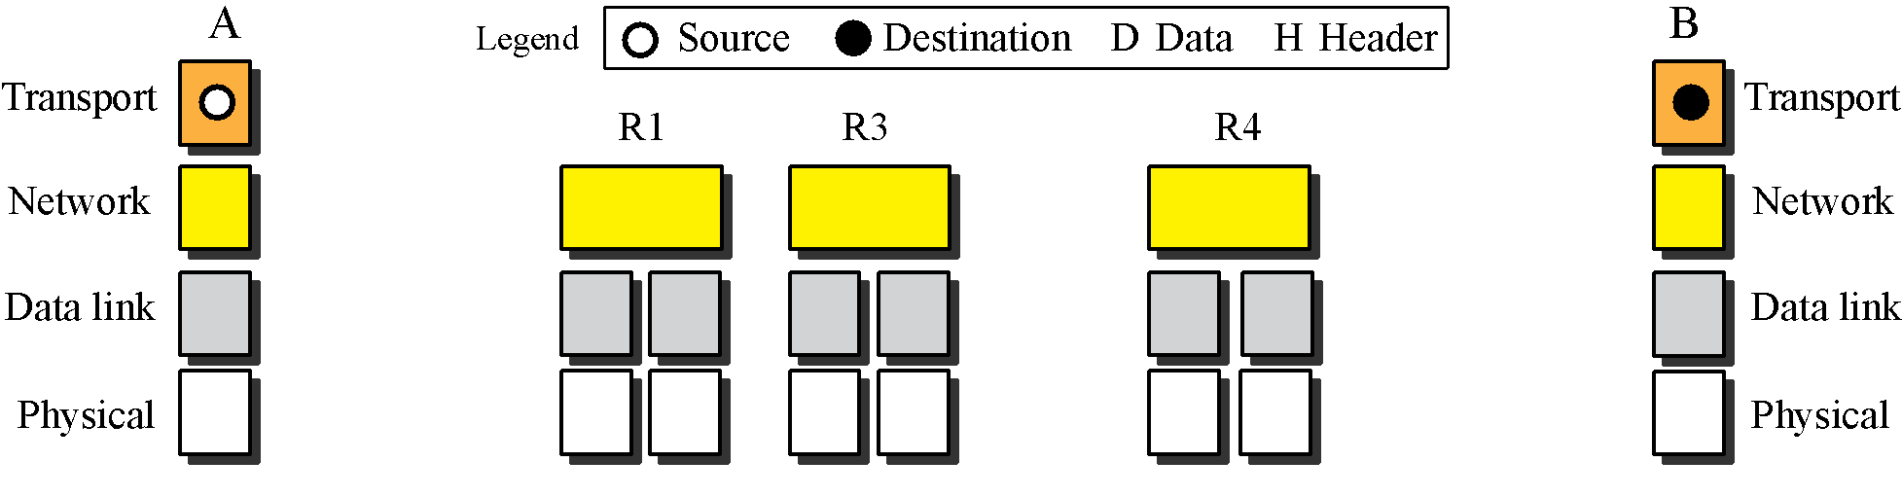

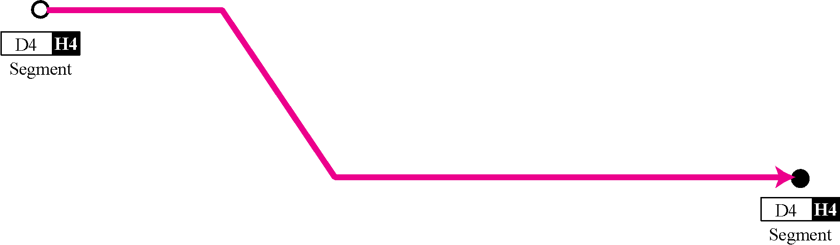
Communication at transport layer

Slide 36
Note
The unit of communication at the transport layer is a segment, user datagram, or a packet, depending on the specific protocol used in this layer.

Slide 37
TCP/IP
Transmission control Protocol/Internet Protocol
Developed by DARPA
No official protocol standard
Can identify four layers
Application
Host-to-Host (transport)
Internet
Network Access
Notes:
DARPA:Defense Advanced Research Projects Agency

Slide 38
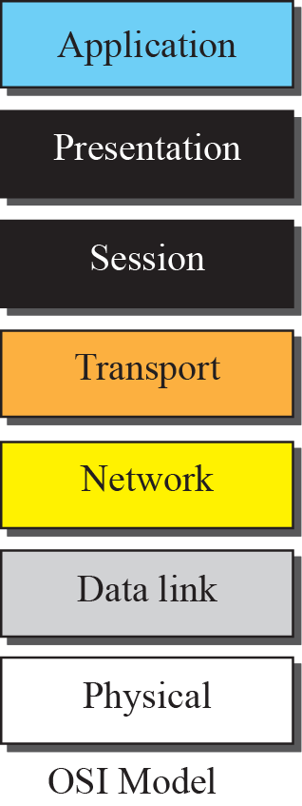
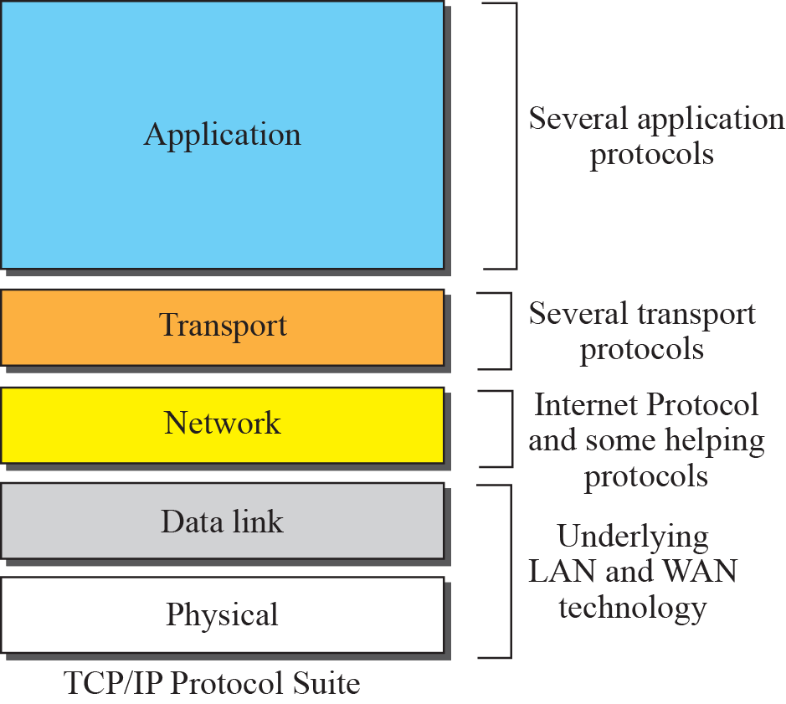
Host to Host
Internet
Network Access

Slide 39
Network Topology
Network topology defines the manner in which the nodes are geometrically arranged and connected to one another.
Types of topology:
Mesh
Star
Bus
Ring

Slide 40
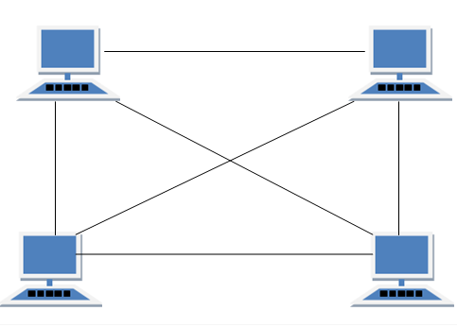
Mesh
Every node has a dedicated
p-t-p link to all the nodes
within network.
The link shares traffic
Between the two nodes only.
Mesh has n(n-1)/2 physical channels to link n devices.
Advantages | Disadvantages
Dedicated link (optimized rate and min traffic) | Large amount of cable and i/o ports
Privacy and security | Redundant link increases cost
No Single point of failure | Difficult in installation
Fault identification easy | Difficult to re-config

Slide 41
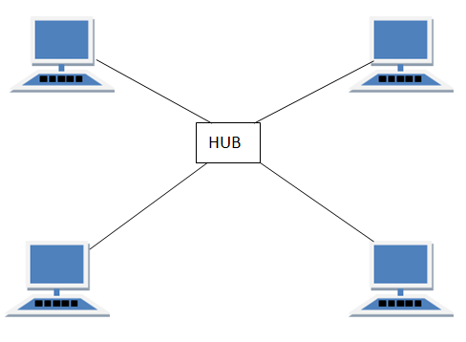
Star
Consists of no of devices
connected by p-t-p links to
central hub.
If a node wants to send data
to another nodes, it sends the
data to central hub, which then relays the data to desired node.
Advantages | Disadvantages
Needs one i/o port and link | Hub failure, entire n/w fails
Easy to install and configure | Cost of installation is high
Link failure, doesn’t affect n/w | Difficult in installationPerformance is based on the hub that is it depends on its capacity
Fault identification easy
Easy to modify (add new node without disturbing the n/w)

Slide 42
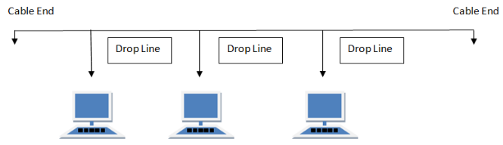
Bus
Uses multipoint cabling i.e multiple devices are connected by means of connectors or drop cables.
One long cable acts as a backbone to link all the nodes.
When a device sends data, its received by all but accepted by once using address.
Bus topology requires termination and cannot be left un-terminated.
Advantages | Disadvantages
Easy to install | Heavy traffic -> slow
Less cables | Difficult reconnection and troubleshooting
No of i/o ports required is less. | Difficult to add new node
Backbone cable can be extended by using repeater | Needs terminators
Cost of n/w is low | Single point of failure (backbone cable)

Slide 43
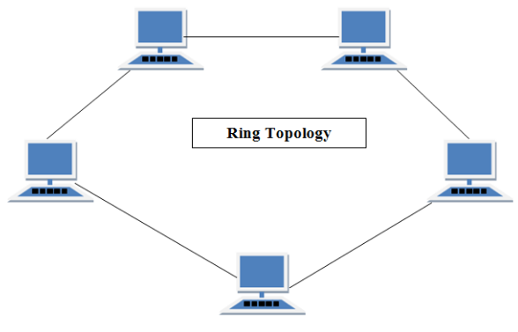
Ring
Each device is connected
by a dedicated p-t-p
Connection to its adjacent
device.
Signal travels in one
direction.
Advantages | Disadvantages
Easy to install. | Max ring length and no of devices is limited.
Link failure is easy | If one node fails, n/w fails.
Transmitting network is not affected by high traffic or by adding more nodes, as only the nodes having tokens can transmit data. | Adding or deleting the computers disturbs the network activity.

Slide 44
Design issues for Layers
Reliability
Error detection
Error correction
Routing
Evolution of network
Protocol layering
Addressing or naming
Internetworking
Scale
Resource allocation
Multiplexing
Flow control
Congestion control
Real-time (QoS)
Security
Confidentiality
Authentication
Integrity

Slide 45
Transmission Mediums
Cat- | Length | Speed | Mhz | Application
Cat-5 | 100m | 100Mbps | 100 | Ethernet, Fast Ethernet, Token Ring
Cat-5e(enhanced) | 100m | 1Gbps | 100 | Ethernet, Fast Ethernet, Gigabit Ethernet
Cat-6 | 100m | 10Gpbs | 250 | Gigabit Ethernet, 10G Ethernet (55m)
Cat-6a(Augmented) | 100m | 10Gbps | 500 | Gigabit Ethernet, 10G Ethernet (55m)

Slide 46
Network Devices
Repeater
Hub
Bridge
Switch
Router
Brouter

Slide 47
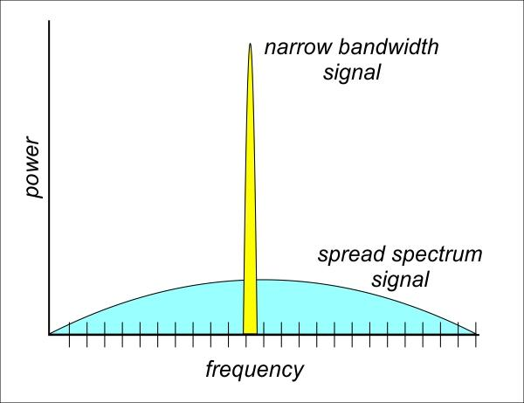
Wireless Communication
Narrow Band Radio Signal
Narrow band of freq, i.e 98.3MHz FM
Requires lots of power
Easy to intercept, jam and interfere
Spread Spectrum Radio Signal
Broad BW
Low power consumption
More secure

Slide 48
SPREAD SPECTRUM
In wireless applications, stations must be able to share the medium without interception by an eavesdropper and without being subject to jamming from a malicious intruder.
To achieve these goals, spread spectrum techniques add redundancy; they spread the org spectrum needed for each station.
If req. BW for each station is B, spread spectrum expands it to Bss. [Bss>>B].
Spread Spectrum achieves its goals through two principles:
The BW allocated to each station needs to be, by far, larger than what is needed. [Redundancy]
The expanding of the original BW B to Bss must be done by a process that is independent of the org signal. In other words, the spreading process occurs after the signal is created by the source.

Slide 49
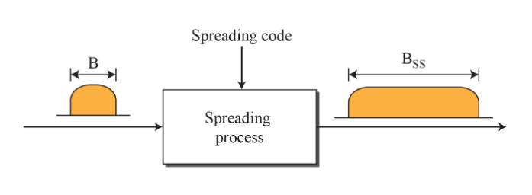
After the signal is created by the source, the spreading process uses a spreading code and spreads the BW.
The spreading code is a series of numbers that look random, but are actually a pattern.
Use of SS
-military
-Cordless phones
-GPS
-Wireless LANs

Slide 50
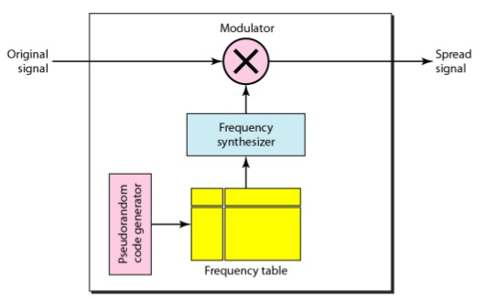
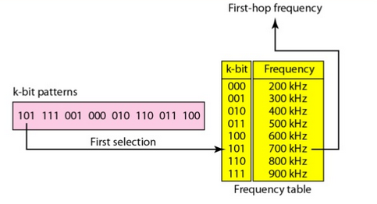
Frequency Hopping (FHSS)
Uses M diff carrier freq that are modulated by the source signal.
At one moment, signal modulates one carrier freq; at the next, another.
The BW occupied by a source after spreading is Bfhss >> B.

Slide 51
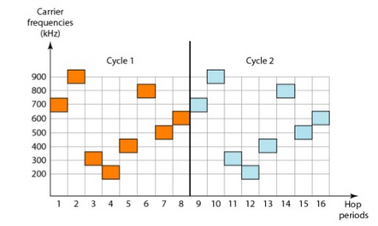

Slide 52
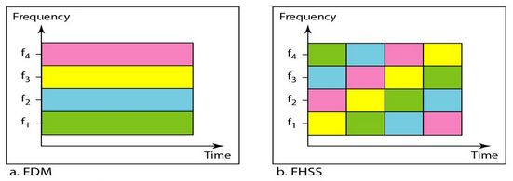

Slide 53
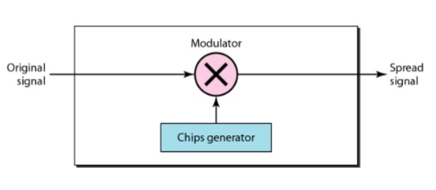
Direct Sequence (DSSS)
In DSSS, each data bit is replaced by n bits using spreading code.
Each bit is assigned a code of n bits,(chips), where the chip rate is n times that of data bit.
In wireless LAN, Bakers sequence is used, where n=11.
The pattern used is 10110111000.

Slide 54
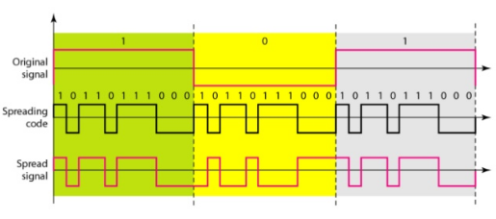

Slide 55
FHSS
FHSS devices will transmit signal by changing or hopping from one freg to another in a random but predictable seq.
Channels: Specific hop pattern
Dwell time: transmits on a freq for a specific amount of time
Hop time: a very small amount of time during a freq change in which the radio is not transmitting.
To be 802.11 compliant FHSS wireless LAN devices must operate in the 2.4GHz-2.5GHz Band.

Slide 56
DSSS
Channel: each ch is a contiguous band of freqs 22 MHz wide
-Ch1 operates from 2.401GHz to 2.423GHz
-Chs are displayed at their center point 2.412GHz +-11

